Slide 1

CS 533 INTRO TO DATA SCIENCE
Michael Ekstrand

Slide 2
CORRELATED ERRORS

Slide 3

Learning Outcomes
Understand the idea of correlated errors and how they can be addressed.
Know when you need to look for a model that can handle correlated error.
Know two models to study further when needed.
Photo by Tyler Nix on Unsplash

Slide 4
Correlated Errors
Observations are not necessarily independent:
Time series: autocorrelated
Within-subjects designs: grouped
Other data may also be grouped
Medical data collected by hospital

Slide 5
Grouping Example
Example problem: measuring search engine effectiveness
Two search algorithms
Users issue queries
Results are assessed for relevance (experts or click logs)
Problem: results are not independent
* Some queries are harder than others

Slide 6
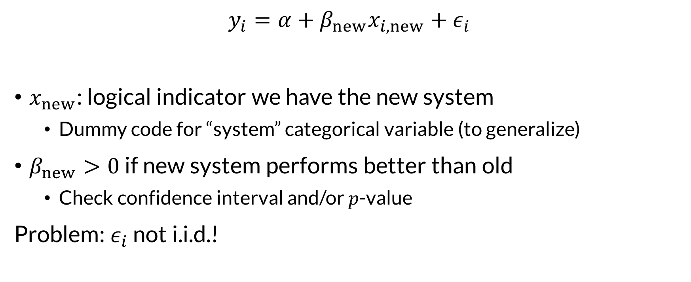
Naïve Solution
$$y_{i}=α+β_{new}x_{i, new}+ε_{i}$$
$x_{new}$: logical indicator we have the new system
Dummy code for “system” categorical variable (to generalize)
$β_{new}>0$ if new system performs better than old
Check confidence interval and/or $p$-value
Problem: $ε_{i}$ not i.i.d.!

Slide 7
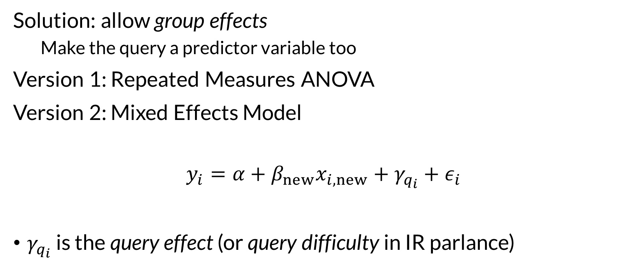
Stratified Errors / Group Effects
Solution: allow group effects
Make the query a predictor variable too
Version 1: Repeated Measures ANOVA
Version 2: Mixed Effects Model
$$y_{i}=α+β_{new}x_{i, new}+γ_{q_{i}}+ε_{i}$$
$γ_{q_{i}}$ is the query effect (or query difficulty in IR parlance)

Slide 8
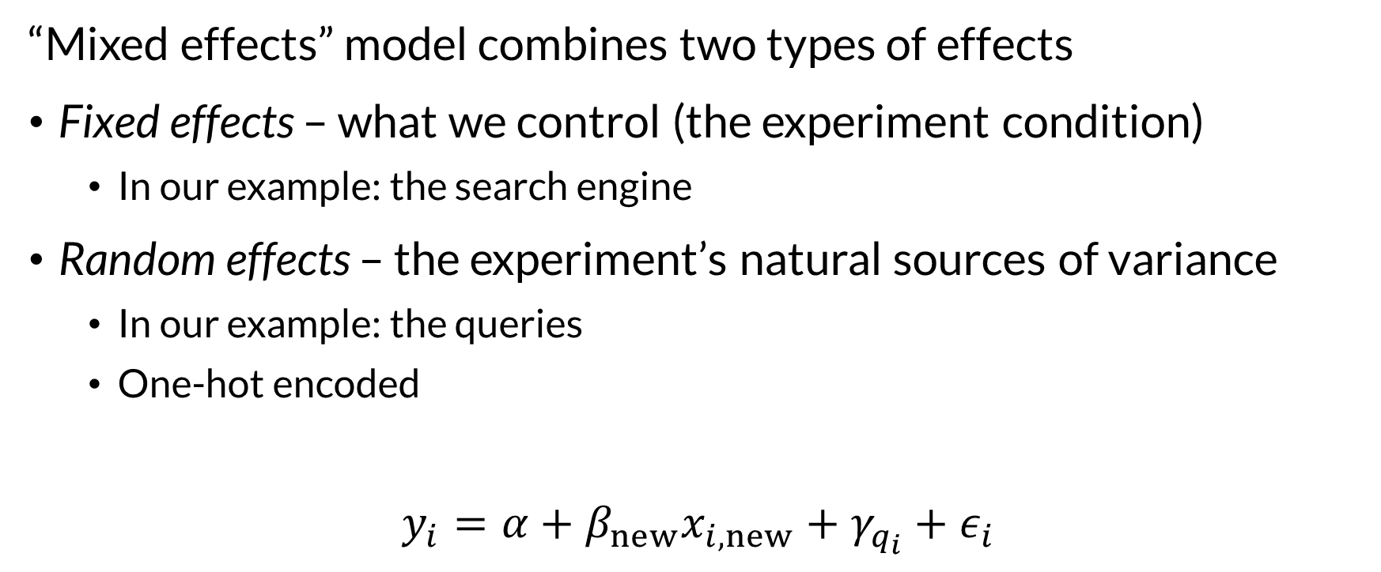

Fixed and Random Effects
“Mixed effects” model combines two types of effects
Fixed effects – what we control (the experiment condition)
In our example: the search engine
Random effects – the experiment’s natural sources of variance
In our example: the queries
One-hot encoded
$$y_{i}=α+β_{new}x_{i, new}+γ_{q_{i}}+ε_{i}$$

Slide 9
Basic Idea: Modeling Additional Effects
Random effects capture natural sources of variance shared between observations
Performance: system effectiveness + query difficulty
Remaining variance (residuals) hopefully i.i.d. normal!
Our linear model works again
This applies generally – if we know an effect in the variance structure, we can remove it (“control for” it).

Slide 10
When To Use Stratified Errors
Any time your data points come in groups
Multiple measurements for the same object
Trying to understand difference between measurements
Understanding diff. between objects, they are fixed effects!
When you have an external feature shared between instances

Slide 11

Autocorrelation
Time series data is correlated with itself
But can we predict $x_{t}$ with $x_{t−1}$?
“Removing” autocorrelation may let a linear model work!

Slide 12
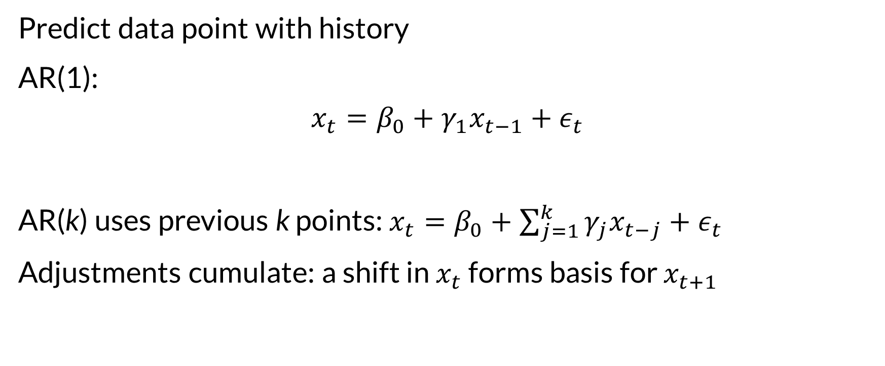

Autoregression
Predict data point with history
AR(1):
$$x_{t}=β_{0}+γ_{1}x_{t−1}+ε_{t}$$
AR(k) uses previous k points: $x_{t}=β_{0}+\sum_{j=1}^{k}{γ_{j}x_{t−j}}+ε_{t}$
Adjustments cumulate: a shift in $x_{t}$ forms basis for $x_{t+1}$

Slide 13
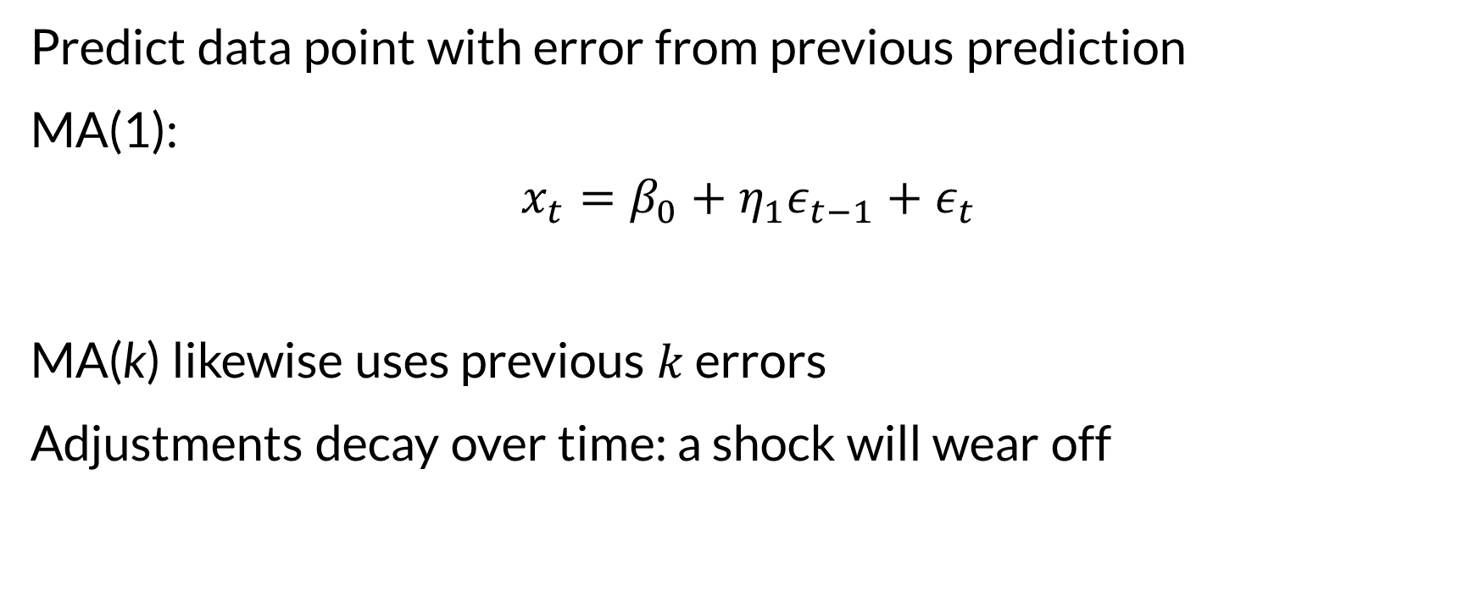
Moving Average
Predict data point with error from previous prediction
MA(1):
$$x_{t}=β_{0}+η_{1}ε_{t−1}+ε_{t}$$
MA(k) likewise uses previous $k$ errors
Adjustments decay over time: a shock will wear off

Slide 14
ARIMA
Auto Regression Integrated Moving Average: ARIMA(p, q, r)
AR(p) model
MA(r) model
Applied to q-order diffs (1 = diff, 2 = diff of diffs)
AR & I can be viewed as a type of feature engineering

Slide 15
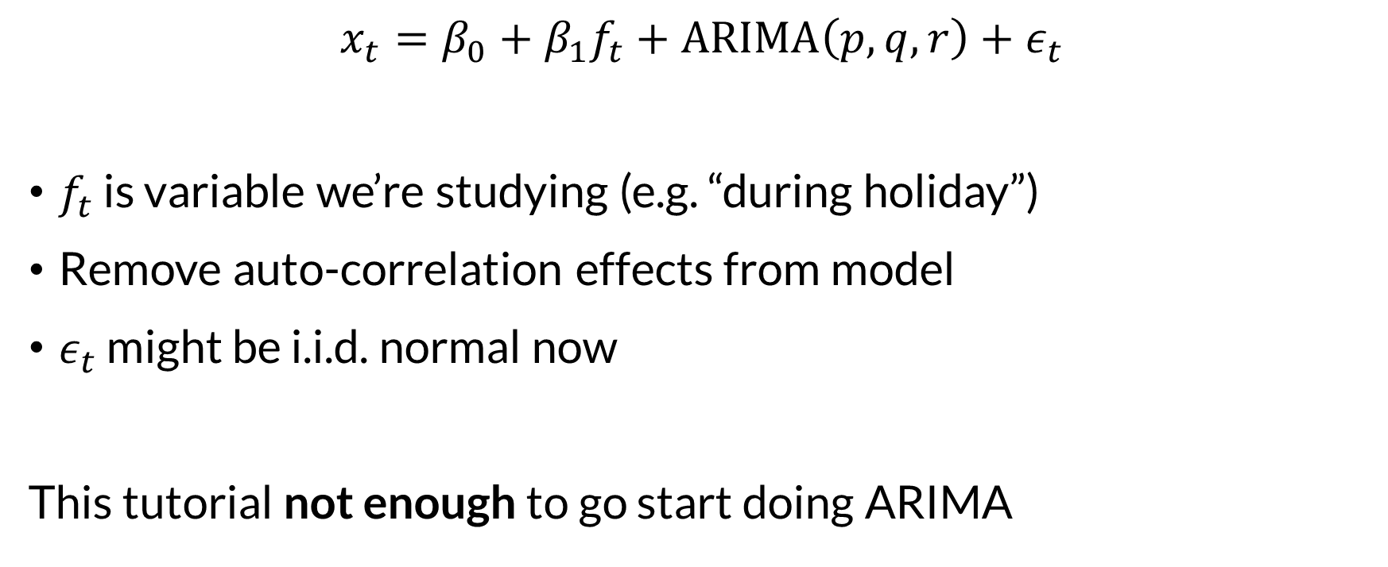

Integration with Prediction
$$x_{t}=β_{0}+β_{1}f_{t}+ARIMA\left(p,q,r\right)+ε_{t}$$
$f_{t}$ is variable we’re studying (e.g. “during holiday”)
Remove auto-correlation effects from model
$ε_{t}$ might be i.i.d. normal now
This tutorial not enough to go start doing ARIMA

Slide 16

Wrapping Up
We often have structured errors in a regression problem.
In some cases, modeling that structure yields a valid model.
Photo by Pawel Janiak on Unsplash

